Slide 1
Welcome to The Physics Department
Monday - Friday:
9:00am - 12:00pm and 1:00pm - 4:00pm
Advising: Available over Zoom
Log in to Slug Success to make an appointment!

Slide 2

Important Dates for Winter Quarter 2022
Quarter Begins | January 3 Monday
Instruction Begins | January 3 Monday
Holidays | January 17, February 21 Monday, Monday
Instruction Ends | March 11 Friday
Final Exams | March 14–18 Monday–Friday
Quarter Ends | March 18 Friday
Holiday (not falling within the quarter) | March 25 Friday

Slide 3
Physics Advising
Undergraduate Advisor:
Brandon Day physicsadvising@ucsc.edu ISB Room 211
Graduate Advisor:
Amy Radovan physgradadvising@ucsc.edu ISB Room 207
Log in to Slug Success to make an appointment!
https://slugsuccess.ucsc.edu/

Slide 4

Physics Department Peer Advisor:
Cam Aristimuno Ots (sher/her)
2022 Winter Quarter Hours:
Physics Advising Office:
Room 211
Monday & Wednesday
1:00 PM - 4:00 PM
Meeting Types:
In-person and Virtual (Zoom)
Sign-up to meet with Cam
and the rest of your advisors at
Slug Success
https://slugsuccess.ucsc.edu/
“[A]lways, let me know if you have any questions (about classes/major paths/etc).” - Cam

Slide 5

Women in
Physics and Astronomy
Monthly meetings
Frequent workshops
Outreach events in community
Stay connected or join the fun!
Insta: @wipaucsc Twitter: @ucscwipa
ucsc.women.in.physics@ucsc.edu
ucscwomeninphysics.wixsite.com/ucscwipa

Slide 6

The Society of Physics Students
A collaborative, prosperous, and safe environment for physics students to get the most out of their undergraduate careers at UC Santa Cruz.
https://ucscsps.com/
The UC Santa Cruz Society of Physics Students is a community that aims to represent the interests of the physics student body, to provide a social environment for it, and to provide academic resources to facilitate the success of its students. In particular, it is crucial for SPS to recognize and combat the continual underrepresentation of women, people of color, international, and LGBTQ+ students in STEM and facilitate an environment where physics students can thrive academically, professionally, and socially.
Weekly meetings! A communal and academic space for physics students.
Mentoring services Influence on future physics curriculum

Slide 7
Trans and GNC in
Physics and Astronomy Coffee Hour
Join-in bi-weekly starting Feb 8th from 2pm - 3pm via Zoom.
Build community while getting to hang out with other cool queer and trans folks involved in the physics and astronomy departments.
Zoom link: https://tinyurl.com/astrotransucsc
Meeting ID: 997 4263 4308
Passcode: transastro
If you’re interested in joining us, feel free to join our discord server!
https://discord.gg/wv5w7gebXZ

Slide 8

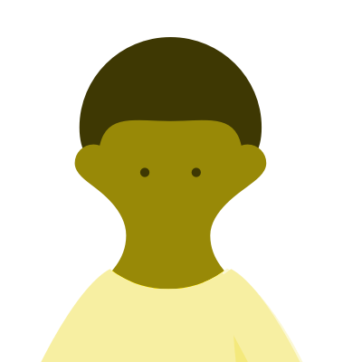
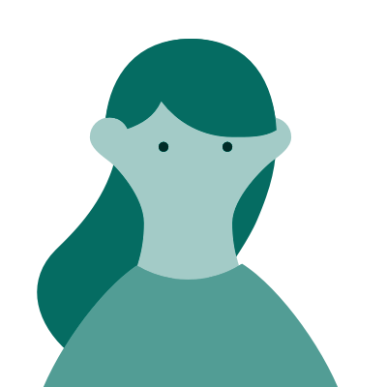
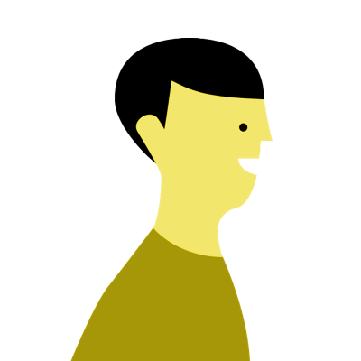
SPS Physics Mentoring Program
Mentors and Mentees Wanted!
Want a mentor to help you navigate physics, college, and life in general? Would you like to share your hard-earned experience with someone earlier in their career? The UCSC Physics Mentoring Program pairs students with others from higher divisions to exchange personal and career enrichment and foster community.
Available for both undergrads and grads, mentored by students of a higher educational level
No prior experience needed. Training will be provided to mentors.
The pairs commit for the academic year to meet regularly at their convenience.
Promoting participant interactions through events (career workshops, panels, socials...) each quarter.
We believe in the importance of support networks in the pathway to success, especially for those belonging to underrepresented communities in STEM. Our goal is to foster these connections by giving students the chance to interact with others who have recently walked a similar path. Mentors will be supporters of their mentee's journey in Physics, in college, and in life, as opposed to serving simply as academic tutors. This also gives mentors the opportunity to be the person who they may have had or have needed in the past.

Slide 9
Diversity
and
Climate Initiatives
The Department of Physics and Department of Astronomy & Astrophysics are fully committed to and supportive of the University of California's Diversity Statement.
“As a community, we acknowledge the richness of commonalities and differences we share, the intrinsic worth of all who work and study here, and that physics education is enhanced by investigation of and reflection upon multiple perspectives. We also aspire to create respect for and appreciation of all persons as a key characteristic of our campus community and to achieve an environment that welcomes and supports diversity as well as ensuring full educational opportunities for all who teach and learn here. This work is essential to furthering the widely shared purposes of maintaining our premier status, noted for its excellence, richness and vibrancy. We are thus deeply committed to ensuring the continued diversity of our campus and will do whatever we can, legally and appropriately, to preserve and expand the diverse nature of our community.”
physics.ucsc.edu/about/diversity
of the
Physics Department
at the
University of California Santa Cruz

Slide 10
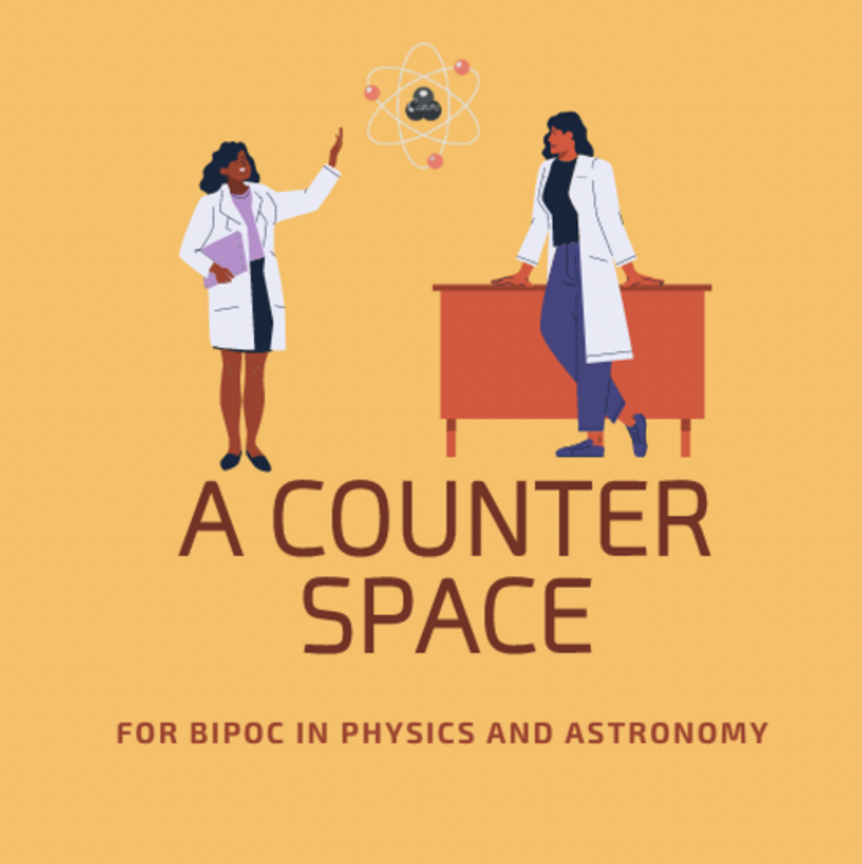

ACS for BIPOC Women in Physics and Astronomy
Visit the website https://ucscwocjc.wixsite.com/acounterspace
For upcoming event and meeting details

Slide 11
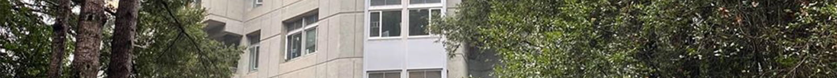
Physics Forum
Tuesday’s 2-3 PM ISB Courtyard Snacks Provided
A weekly, informal meeting for physics graduates, undergraduates, and enthusiasts, aiming to promote an atmosphere of inclusion in the Physics department, and encourage discussion between physicists of all levels. Discuss any number of topics like homework help, physics colloquia, graduate school applications, research opportunities, outreach opportunities, programming, LaTeX, puzzles, math, philosophy… and really, nothing is off the table.
Everyone is welcome!

Slide 12

No Jargon Talk Series
The Outreach Task Force is proud to present the UCSC Physics No-Jargon Talk Series. Particularly geared towards undergrads, these biweekly talks feature the cutting edge research at UCSC and beyond, delivered without using jargon.
If you are interested in learning more about research, seeking research opportunities, expanding your network, discussing science, or presenting your own project, come join in on the fun!
Zoom at this URL: https://tinyurl.com/nojargontalks
Every Other Tuesday
at 3:00 - 4:00 pm
Center for Adaptive Optics Lounge and Zoom

